Slide 1
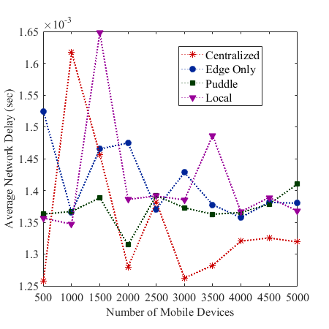
pFogSim: A Simulator for Evaluating Dynamic and Layered Fog Computing Environments
Jacob Hall; Jay McKinley; Clayton Johnson; Shehenaz Shaik; Sanjeev Baskiyar
Samuel Ginn College of Engineering, Auburn University
Introduction
Network Model and Orchestrators
Preliminary Results
With heavy growth in network computation models (Cloud, Edge, Fog, Mist, Dew, etc), there need to be large tests. Issues…
Creating physical networks of SmartCity scales are expensive
Need to pay for power, hardware, people, etc
All for something that may not work.
Simulators are the most efficient way to test new network architectures. Issues…
Simulators are often built for niche architectures
Lacking documentation
Assumptions are too generous
No mobility of nodes/changing networks
What does pFogSim change?
Built to test multiple architectures
Up-to-date documentation
Made to handle changing networks and mobile devices
Realistic network simulator
NodeSim : Made to represent each machine on the network
Link : Represents each connection between network nodes
Decreases amount of code changes needed since links aren’t built into EdgeCloudSim
NetworkTopology : Combines all the NodeSim and Link objects and updates throughout network if necessary.
Router : Non-Centralized approach provides optimal routes across the network.
Cloud-only Orchestrator
Only allows execution of apps on the Cloud
Edge-only Orchestrator
Execution only occurs on the edge (low-level) devices, prioritizing executing closer to the user.
Puddle/Distance-based Orchestrator
Executing applications as close to the user as possible while only having localized information.
Local-only Orchestrator
Only executes on the nearest bottom level Fog device
Centralized Orchestrator
Places applications on the ideal nodes according to distance
This one is extremely unrealistic as it assumes every node in the network has the up-to-date network state.
Hypothetical smart city dataset with 781 prospective fog nodes includes five types of fog nodes, each represented by a fog layer, and vary in resource configuration and mobility characteristics.
Fog nodes belonging to each layer represented by a unique color.
Nodes belonging to same fog layer are grouped into Puddles using Agglomerative Complete Linkage Hierarchical Clustering approach.
Parent-child relationships among Puddles in adjacent layers are formed using Complete Linkage method.
HAFA facilitates fully distributed resource management and allocation, using local system state knowledge.
Defined Terms
Static Network State
Network information that does not change due to the simulation
i.e. datacenter locations, hardwire connections
Dynamic Network State
Network information that changes due to the simulation
i.e. cpu/network utilization
Centralized Orchestration/Approach
Uses static and dynamic state information from the entire network
Localized Orchestration/Approach
Uses static and dynamic state information from a subset of the network
Non-Centralized Orchestration/Approach
Uses only static state information
Test Scenarios
Using Chicago Dataset to simulate SmartCity using various application placement strategies throughout network
Network has >1000 fog nodes spread out over various distances over Chicago (Except for Google Cloud server in Washington D.C.)
There are multiple levels in the network:
1 Google Cloud Server (Washington D.C.) (Level 7)
1 server in City Hall (Level 6)
10 University servers (Level 5)
51 Ward servers (Level 4)
81 Library Servers (Level 3)
254 Connect Servers (Level 2)
681 School Servers (Level 1)
Varying number of mobile devices (Level 0)
Network connections
Level 7 connects to Level 6,
Level 5 to all nodes below and the to two closest Level 5 nodes
From EdgeCloudSim to pFogSim
Work in Progress
pFogSim is a mix of two larger network simulators: iFogSim and EdgeCloudSim
What we used from iFogSim:
Network Topology design
Routers
Static Links
What’s been done to EdgeCloudSim:
Added iFogSim ideas
Changed how device mobility operates + Extended to all nodes within network
Added more orchestrators
Developing Simulator:
Event-based simulator extended from iFogSim and CloudSim.
Supports mobility of IoT devices, fog nodes, and users.
Supports multi-layered hierarchy of heterogeneous fog nodes.
Supports organization of fog nodes into Puddles.
Facilitates testing of various service deployment strategies and application environments.
Contact
References
Shehenaz Shaik; Sanjeev Baskiyar
Samuel Ginn College of Engineering
Email: (szs0117, baskisa}@auburn.edu
Website: http://www.eng.auburn.edu/~baskisa/
Phone: (334)-844-6306
A. A. Alsaffar, H. P. Pham, C. -S. Hong, E. -N. Huh, and M. Aazam. 2016. An Architecture of IoT Service Delegation and Resource Allocation Based on Collaboration between Fog and Cloud Computing. Mobile Information Systems (Aug. 2016).
C. Chang, S. N. Srirama, and R. Buyya. 2017. Indie Fog: An Efficient Fog-Computing Infrastructure for the Internet of Things. Computer. 50, 9 (Sep. 2017), 92-98.
S. Shaik, and S. Baskiyar. 2018. Hierarchical and Autonomous Fog Architecture. ICPP ’18 Comp, August 13–16, 2018, Eugene, OR, USA. In press. DOI: https://doi.org/10.1145/3229710.3229740.
M. Taneja, and A. Davy. 2017. Resource aware placement of IoT application modules in Fog-Cloud Computing Paradigm. IFIP/IEEE Symposium on Integrated Network and Service Management (IM, 2017). 1222-1228.

